Slide 1
Different Levels of Testing

Slide 2
In software testing, we have four different levels of testing, which are as discussed below:
Unit Testing
Integration Testing
System Testing
Acceptance Testing
Unit Testing : checks if software components are fulfilling functionalities or not. Integration Testing : checks the data flow from one module to other modules. System Testing : evaluates both functional and non-functional needs for the testing. Acceptance Testing : checks the requirements of a specification or contract are met as per its delivery.

Slide 3
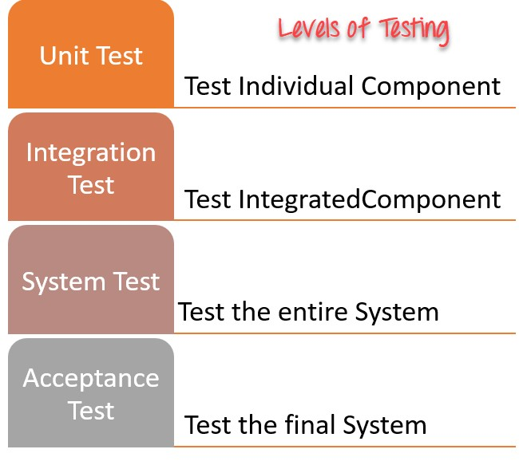
Each of these testing levels has a specific purpose. These testing level provide value to the software development lifecycle.

